Slide 1
Ensemble Learning
Mahipal Singh

Slide 2
Ensemble Learning
1. Introduction
Definition: Combining multiple models to improve performance over a single one.
Goal: Reduce variance (overfitting), bias (underfitting), or improve predictions.
Types:
Bagging – Reduces variance.
Boosting – Reduces bias.
Stacking – Learns how to best combine models.

Slide 3
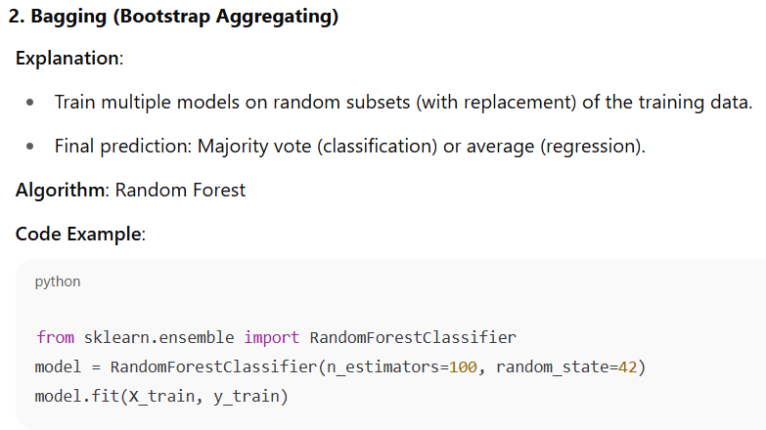

Slide 4
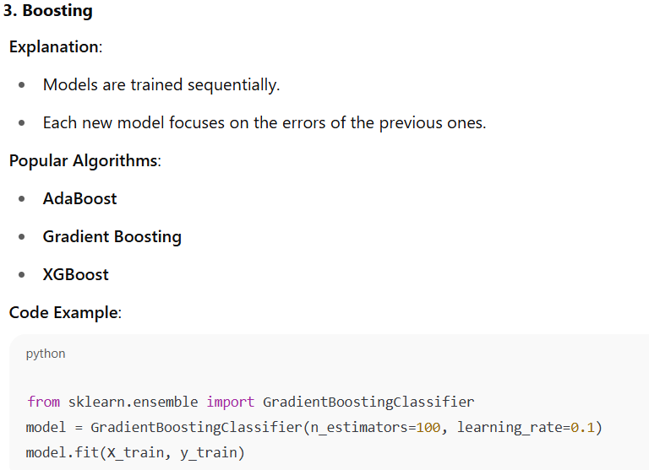

Slide 5
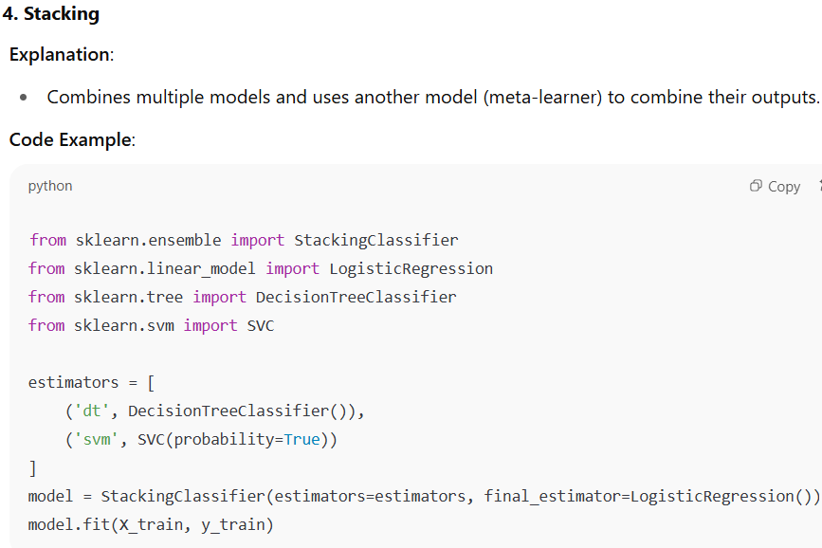

Slide 6
